Slide 1
Anytime Fitness “Get Fit Anytime”
A Service of
Professional Business Associates

Slide 2
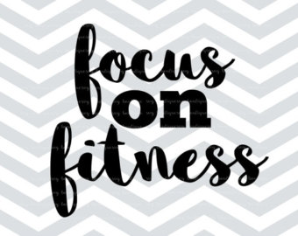
Benefits of Exercise
Increased Health
More Energy
Lower Insurance Costs
Longer Life

Slide 3
The Bottom Line
Graders: Students were instructed to choose main points for bullets.
Exercise and physical activity are a great way to feel better, gain health benefits and have fun. As a general goal, aim for at least 30 minutes of physical activity every day.
If you want to lose weight or meet specific fitness goals, you may need to exercise more.
Remember to check with your doctor before starting a new exercise program, especially if you haven't exercised for a long time, have chronic health problems, such as heart disease, diabetes or arthritis, or you have any concerns.

Slide 4
Anytime Fitness Information
Hours | 6 am – 10 pm Daily
Location | First Floor – Room 1B
Director: | Andrew Christian
Slogan | “Get Fit Anytime”
Cost | Free To All Employees
Thank you. We look forward to seeing you soon! Exercise is Fun!!!

